Slide 1
Introductory General Chemistry
Chemistry 3A
Experiment 12a
pH of Household Items
Mitch Halloran

Slide 2
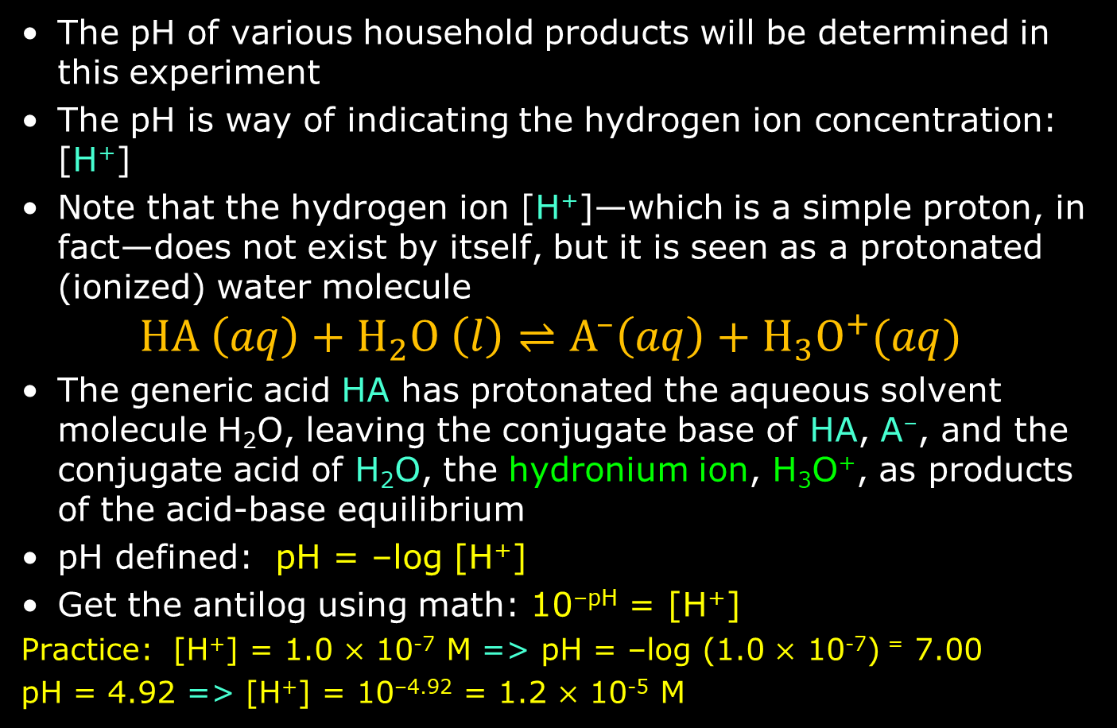
Introduction
The pH of various household products will be determined in this experiment
The pH is way of indicating the hydrogen ion concentration: [H⁺]
Note that the hydrogen ion [H⁺]—which is a simple proton, in fact—does not exist by itself, but it is seen as a protonated (ionized) water molecule
$$HA \left(aq\right)+H_{2}O \left(l\right)⇌A^{–}\left(aq\right)+H_{3}O^{+}(aq)$$
The generic acid HA has protonated the aqueous solvent molecule H₂O, leaving the conjugate base of HA, A–, and the conjugate acid of H₂O, the hydronium ion, H₃O⁺, as products of the acid-base equilibrium
pH defined: pH = –log [H⁺]
Get the antilog using math: 10^{–pH} = [H⁺]
Practice: [H⁺] = 1.0 $×$ 10⁻⁷ M => pH = –log (1.0 $×$ 10⁻⁷) ⁼ 7.00
pH = 4.92 => [H⁺] = 10^{–4.92} = 1.2 $×$ 10⁻⁵ M

Slide 3
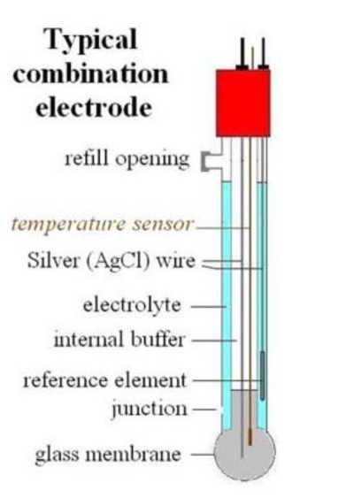
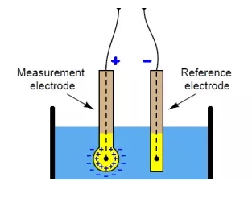
Introduction
The measurement of pH typically in the analytical laboratory is done using $500-1500 of equipment.
The most important device of the
equipment are the electrodes that
actually measure the pH: a
pH or measurement electrode, and
reference electrode
Nowadays these electrodes are
contained in a single unit, the
combination electrode

Slide 4
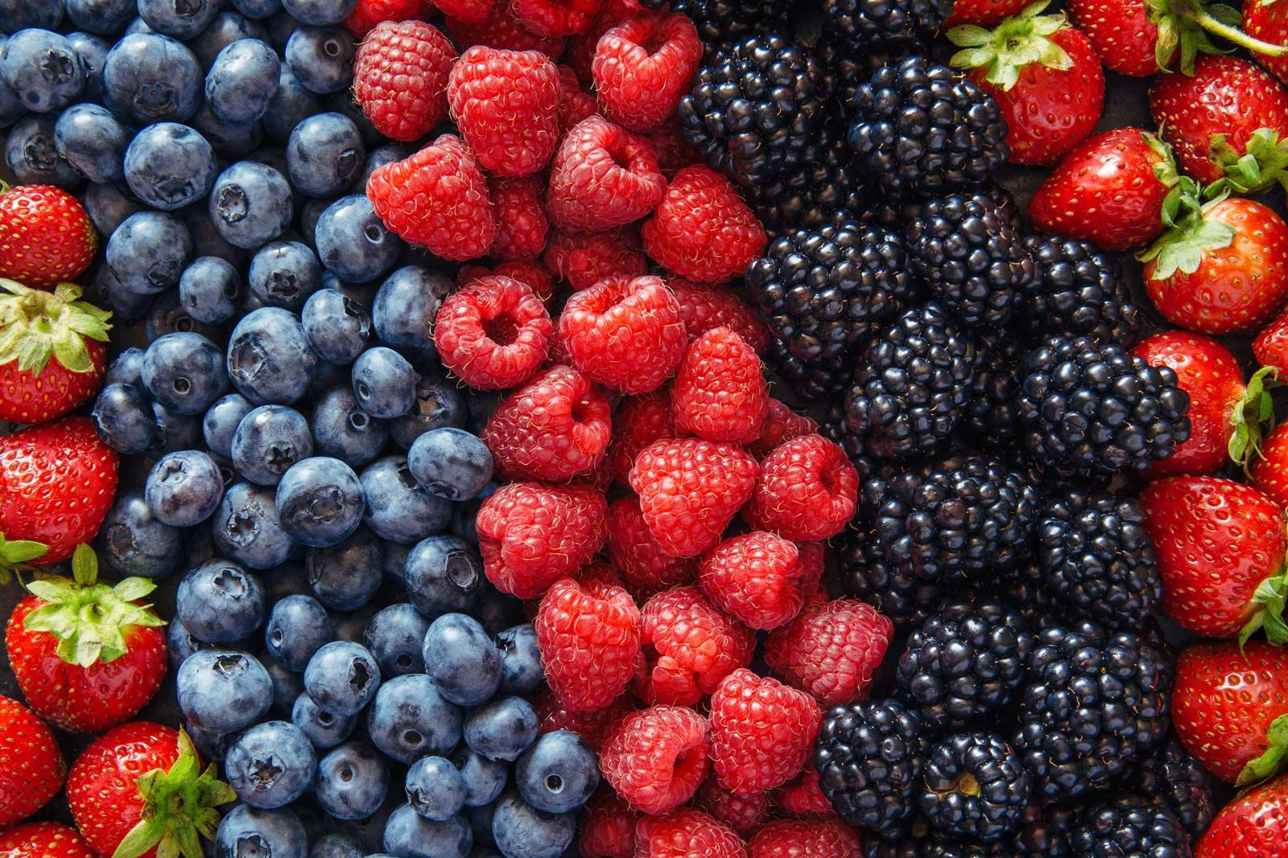
Introduction
Other less costly and useful ways of determining pH are indicator dyes
These dyes can be obtained from natural (plant) products which are colorful
The color can change when the pH is within certain ranges, such as acidic, neutral, or basic
One class of indicator
dyes are anthocyanins
Anthocyanins provide the
color to many fruits and
vegetables. They in part
account for red/crimson
leaf color in the autumn

Slide 5
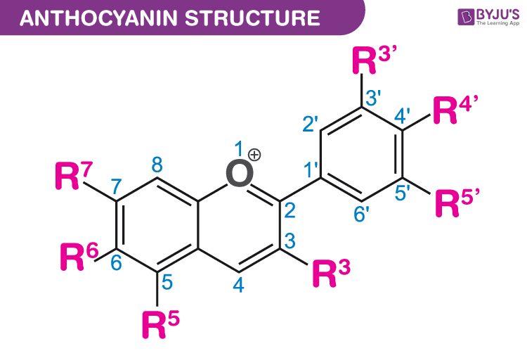
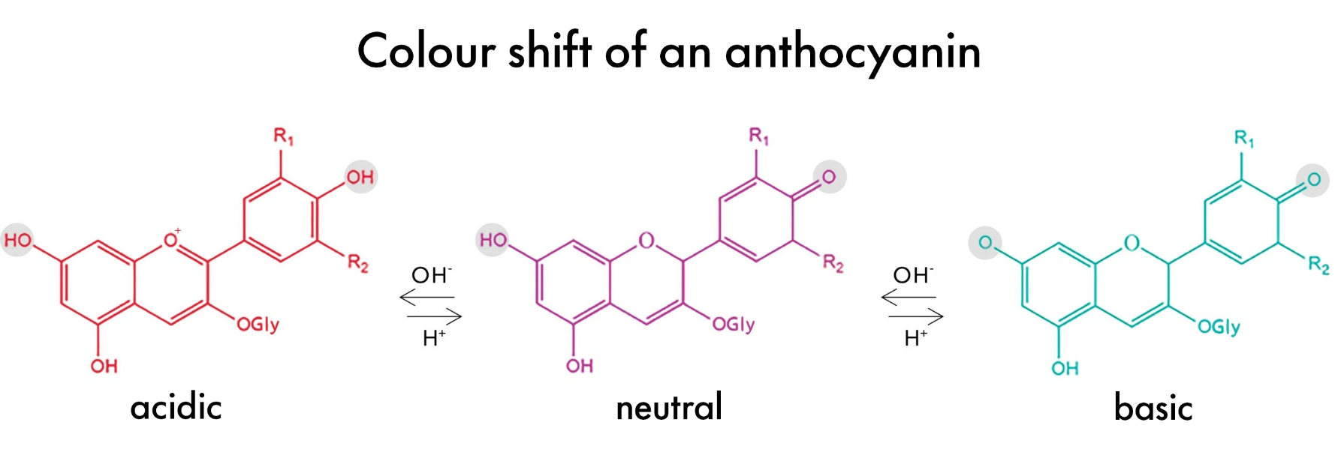
Introduction
Anthocyanins are polycyclic organic
molecules whose structure creates
emissions in the colorful visible
EM spectrum
Other classes of biomolecules
producing colors include
carotenoids and xanthophylls
Below is shown how acidic, neutral, and basic environments create the colors

Slide 6
Introduction
Anthocyanins are polycyclic organic
molecules whose structure creates
emissions in the colorful visible
EM spectrum
Other classes of biomolecules
producing colors include
carotenoids and xanthophylls
Below is shown how acidic, neutral, and basic environments create the colors

Slide 7
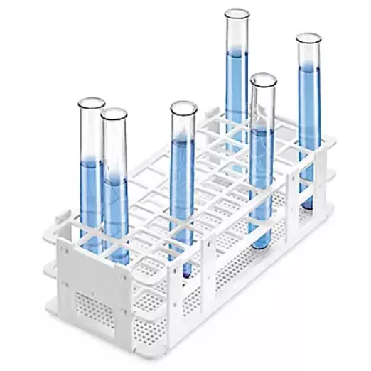

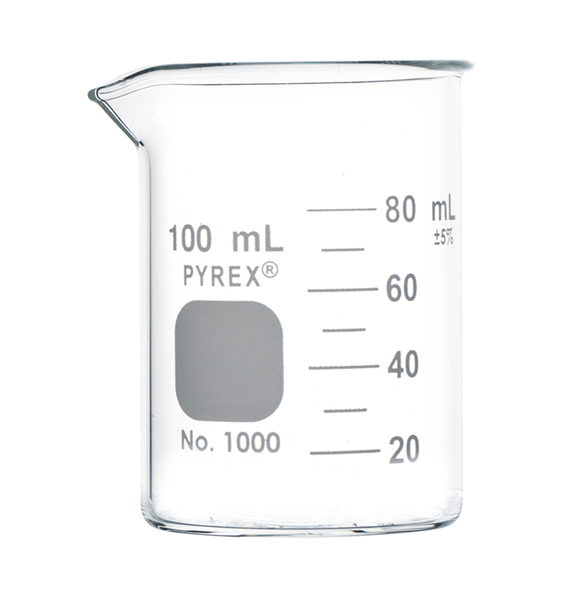

Equipment You Will Use

Slide 8
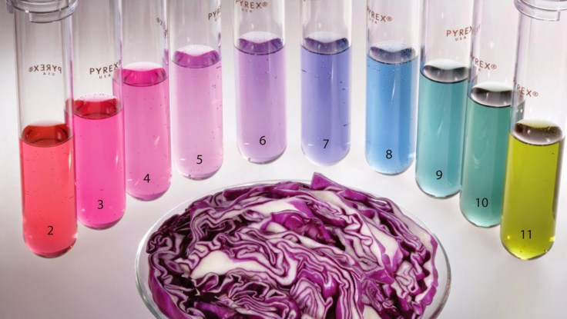
Consumables You Will Use
Red cabbage juice
as a pH indicator dye

Slide 9
Procedure
Follow procedure in your lab manual
Clean Up
Discard tube solutions and station solution in inorgance aqueous waste
Clean tubes with mild soapy water, then rinse well with DI water. Invert tubes on drying rack.

Slide 10
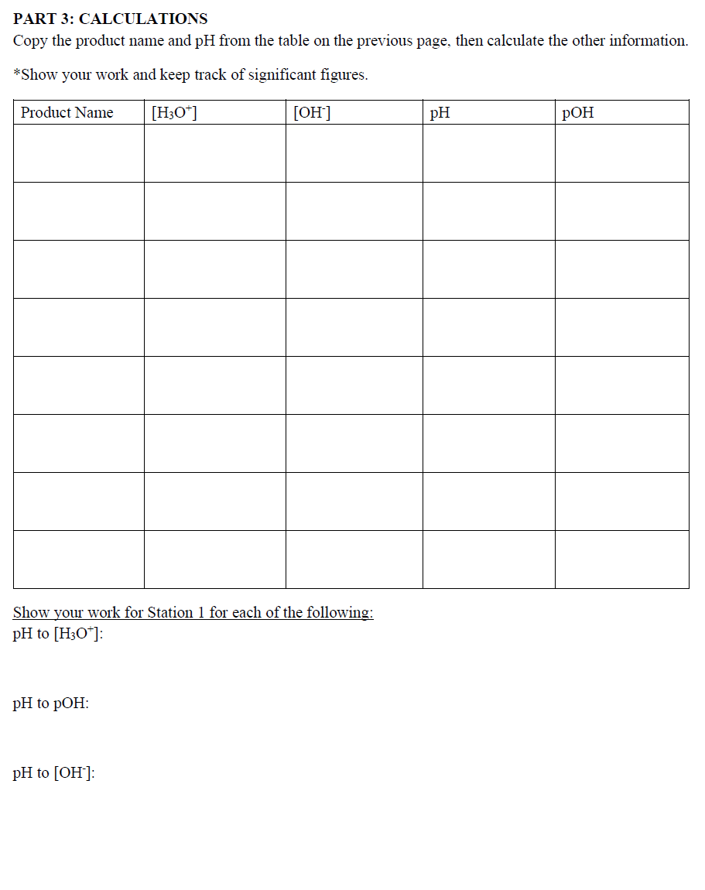
Example Data Analysis

Slide 11
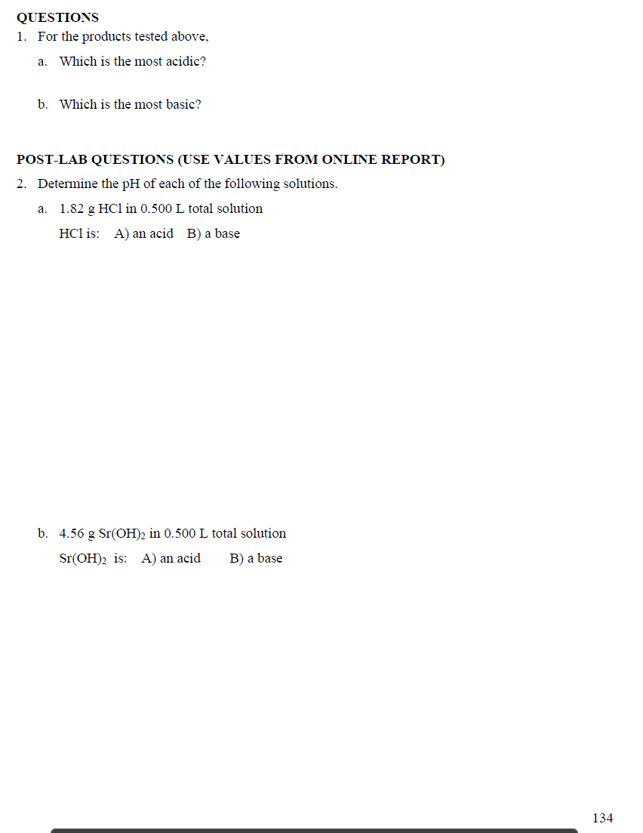
Example Data Analysis

Slide 12
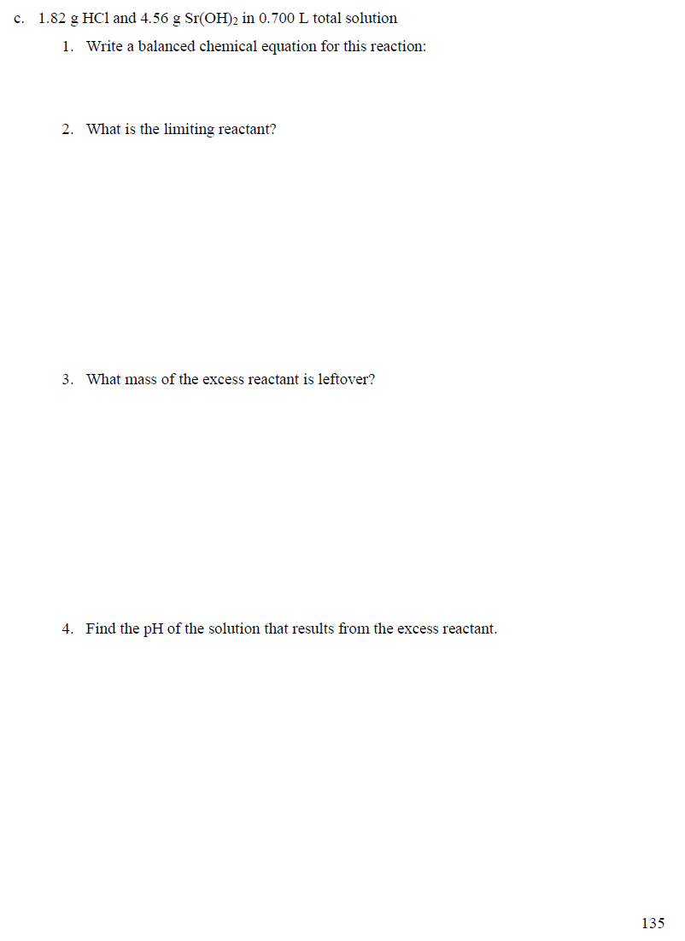
Example Data Analysis

